Slide 1
Contributing to Django
How I learned to stop worrying and just try to fix an ORM Bug
Notes:
Talk slowly

Slide 2
First DjangoCon?
Notes:
Talk slowly
How many people are attending their first DjangoCon
ACTION: Get a drink of water

Slide 3
Introduction
Notes:
My name is Ryan Cheley.
I work for a Medical Services Organization in Southern California.
Part of my duties include managing a team of web developers and one of our newer projects is an internal Django App
Today I’m going to talk about the fantastic experience I had in trying to fix a bug in the Django ORM
ACTION: Get a drink of water
But first, a side quest

Slide 4

Notes:
When I was 15 (in 1993) my Boy Scout troop did a trip to Mt Whitney.
There I was ... at the top of the Mt Whitney Portal, 13,600 ft (4159 m) above sea level
I had spent the 7 days hiking to get here.
ACTION: Drink Water
I was only 3 miles from the summit of Mt Whitney ... but I wasn't sure I could go any further.
My hiking companions told me I didn't look so good. Truth be told, I didn't feel so good either.
Did I make it to the summit?

Slide 5
Trying to get to DjangoCon US
2018
2019
2020
2021
2022
💼
💼
🦠
🧑🏻‍💻
🧍🏻
🎉
Notes:
I’ve been trying to make it to DjangoCon US since 2018
2018: But, I had a work conference I had to attend.
2019: It happened again in 2019
2020: I was *determined* to go in 2020 ... but we all know what happened there
2021: I was able to attend the online version in 2021
2022: And then I finally made it in person 2022 … And it was amazing.

Slide 6

Notes:
ACTION: Take a sip of water
You can see me in the pictures on the left … I had *slightly* longer hair then ☺

Slide 7
🏃🏻‍♂️
Notes:
Sprints
I was very excited about attending the sprints and working on *something* (ACTION: Wave your arms) ORM related
My strategy for finding a ticket was to find something old, that seemed straightforward(ish) and then just go for it.
I spent some time during the conference
trying to find something,
and by the day of the sprints
I had been able to narrow it down
to a single ticket

Slide 8
Criteria
Old?
It was opened in January of 2009
Straightforard(ish)
It’s related to SQLite
Ticket 10070
Named parameters not working on raw sql queries with sqlite
Reported by Matias Surdi

Slide 9
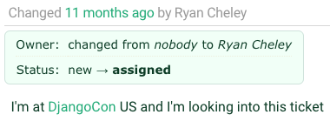
Notes:
I assigned the ticket to myself
ACTION: take a sip of water

Slide 10
🔍
Notes:
Reviewing the Ticket
I spent time reviewing the ticket
Then I spoke with Simon Charette about it.
It *seemed* as though it wasn't a problem anymore

Slide 11
My Trac Comment
In looking at the tests in raw_query\tests I see a few tests that already exist
These are already available and appear to be testing the very thing that the ticket is asking for.
Notes:
And so I added a comment to the ticket

Slide 12
🎉
Notes:
Marking the Ticket as Done!

Slide 13
Comment
Thanks for looking into this. I can get back to work now :)
By Matias Surdi
The Reporter of the Issue!
Notes:
A comment on the issue thanking me for working on the ticket … the original reporter for the ticket!

Slide 14
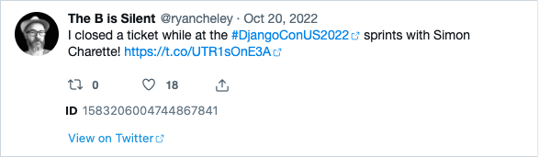
Letting everyone know!
Notes:
I was so excited that I let the world know about it on Twitter / X
ACTION: take a sip of water

Slide 15
🏠
Notes:
I spent the rest of my time at the sprints
working on other
non-ORM related tickets
in other Django related projects
When it was all over
I headed home
having been able to fix a bug
in the ORM!!!!
ACTION: Take a sip of water

Slide 16

Notes:
And I felt *really* good about this
This is a scene from the James Cameron movie Titanic (released December 19, 1997) when Leonardo Dicaprio’s character says, “I’m the king of the world!”
Funny Story … I’ve never seen this movie

Slide 17
But then …

Slide 18
Another Comment
Sorry -- this is still broken on Sqlite. The additions and fixes mentioned are mostly for Oracle and other backends. The Sqlite backend, at the time I write this, still has
supports_paramstyle_pyformat = False
and still borks with a syntax error if you try to replicate the session in the ticket description.
By Shia Berger
Notes:
Shai Berger is a member of the Django Security team

Slide 19
😩
Notes:
Oh No!
I was faced with two potential choices:

Slide 20
🙈🙉🙊
Notes:
Ignore the bug. It had been a bug for YEARS … it was opened on January 19, 2009 (13 YEARS!!!!) and didn’t seem to have caused any MAJOR issues

Slide 21
🛠️
Notes:
Fix
Try to work it on my “own”

Slide 22
Feelings …
Notes:
I also had lots of feelings surrounding the discovery of the bug still existing

Slide 23
😳
Notes:
Embarrassed
I declared it fixed on Twitter
I had people at the DjangoCon Sprints ASK ME HOW I DID IT!
ACTION: Take a sip of water

Slide 24
😞
Notes:
Disappointed
I felt like I let people down
I felt like I let *myself* down

Slide 25
😨
Notes:
Fear
Imposter Syndrome – Can I work on this on “my own”
ACTION: Take a sip of water

Slide 26
Community
Notes:
But then I remembered a talk that Carlton Gibson gave
at DjangoCon US 2018
Entitled
“Your Web Framework Needs You”.
It's a great talk and you should totally watch it,
but here are the highlights that I got out of it

Slide 27
Your Web Framework Needs You!
Ticket difficulty
The Review Process can be challenging
You can do it!
Notes:
1. The vast majority of tickets are no harder than the work you do to solve every single day using Django
a. Yes they need, time, thought, and a little bit of your love
b. If you get stuck while trying to solve it you can ask for help!
ACTION: take a sip of water
2. The review process is hard
a. … and everyone gets the same review process;
b. it’s not personal
ACTION: take a sip of water
3. You can do it.
a. You are qualified!
b. If you’ve spent time working on an issue you are the World Expert (ACTION: go to Next Slide)

Slide 28
The World Expert
I was wondering if this is being work on or if I could try and pick it up, happy to work on it in a group as well
Hi Sarah - you're very welcome to pick it up. :)
I'd suggest an initial time-boxed investigation to work out what the state of play is.
At that point you'll be the world expert TM on this issue, so either you'll have an idea or you'll want input. If you open a PR at that point (even just adding comments in the second case) to explain what's going on, it's easier for others to get up to speed and input
Notes:
Advice from former Fellow Carlton Gibson to current Triage and Review team member Sarah Boyce before she was a member of the Triage and Review team

Slide 29
Working on the Ticket
Notes:
I went to work on the ticket and did what most of us do when we’re assigned a Bug for work, or on a personal project

Slide 30
Replicate the Bug 🐛
Read some docs 📖
Write some code ✍🏻
Test the Code 🧪
Write down what you learned 📜

Slide 31
🐛
Notes:
Replicate the Bug

Slide 32
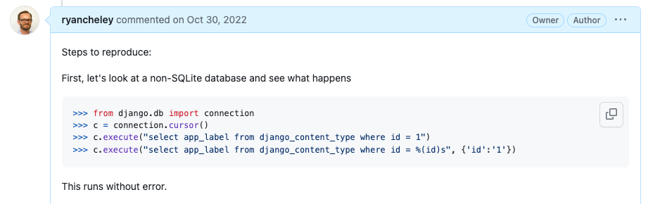
Notes:
In this case I was running against a Postgres database

Slide 33
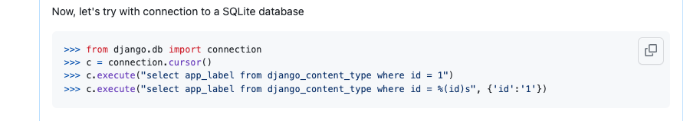

Slide 34
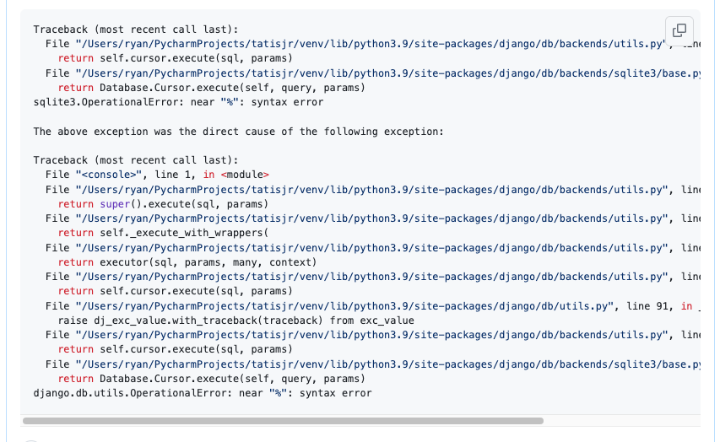

Slide 35
✅ Replicate the Bug 🐛
Read some docs 📖
Write some code ✍🏻
Test the Code 🧪
Write down what you learned 📜

Slide 36
📖
Notes:
Read some docs

Slide 37
Results of Research
Stack Trace Error Message
File "/Users/Ryan/PycharmProjects/tatisjr/venv/lib/python3.9/site-packages/django/db/backends/sqlite3/base.py", line 357, in execute
return Database.Cursor.execute(self, query, params)
Notes:
The second to last line of the Stack Trace says
File "/Users/ryan/PycharmProjects/tatisjr/venv/lib/python3.9/site-packages/django/db/backends/sqlite3/base.py", line 357, in execute
return Database.Cursor.execute(self, query, params)
So let’s start at Django.db.backends.sqlite3.base.py line 357

Slide 38
Results of Research
This leads to the class SQLiteCursorWrapper which has three methods:
execute
executemany
convert_query

Slide 39
Results of Research
BUT both execute and executemany call convert_query if there are parameters (which is the use case we’re interested in)

Slide 40
Results of Research
The code for convert_query is a single line:
def convert_query(self, query):
return FORMAT_QMARK_REGEX.sub("?", query).replace("%%", "%")
Notes:
So it looks like it's checking to see if the regex is pre-compiled, and if it is it's saying don't use any flags, but if it's not pre-compiled you can use flags. Either way, it's returning SimpleLazyObject object type which is defined in django.utils.functional

Slide 41
Results of Research
BUT
FORMAT_QMARK_REGEX = _lazy_re_compile(r"(?<!%)%s")

Slide 42
Results of Research
AND looking at the source code of _lazy_re_compile()
It has two parameters
regex
flags
it returns a SimpleLazyObject
Notes:
So it looks like it's checking to see if the regex is pre-compiled, and if it is it's saying don't use any flags, but if it's not pre-compiled you can use flags. Either way, it's returning SimpleLazyObject object type which is defined in django.utils.functional

Slide 43
Results of Research
Per the doc string a SimpleLazyObject is
A lazy object initialized from any function. Designed for compound objects of unknown type. For builtins or objects of known type, use django.utils.functional.lazy.
And it subclasses LazyObject

Slide 44
Results of Research
Which has the doc string
A wrapper for another class that can be used to delay instantiation of the wrapped class. By subclassing, you have the opportunity to intercept and alter instantiation. If you don't need to do that, use SimpleLazyObject.

Slide 45
Results of Research
At some point I’m able to determine that the raw() method on the object manager is the problem, but I don’t know how I do that
This slide will server as a place holder so I can move onto the next slides

Slide 46
Results of Research
But the actual problem is the raw() method on the object manager!

Slide 47
✅ Replicate the Bug 🐛
✅ Read some docs 📖
Write some code ✍🏻
Test the Code 🧪
Write down what you learned 📜

Slide 48
✍🏻
Notes:
Write some code

Slide 49
Ideas for a fix
This query fails
select * from django_content_type where id = %(id)s", {'id': '1’}
While this query succeeds
select * from django_content_type where id = :id", {'id': '1'}
Notes:
SO ... what needs to be done is to somehow transform the first string into the second, accounting for all of the ways that someone could put in a parameter set.

Slide 50
Ideas for a fix
Use a Regular expression!

Slide 51
My Regular Expression
query = re.sub("\)s", "", re.sub("%\(", ":", query))
Notes:
But as the (paraphrased) saying goes, I had a problem so I used a Regular Expression and now I have two problems - Jamie Zawinski

Slide 52
My Regular Expression
I posted my initial idea to the ticket in Trac
And went to more fully test the implementation

Slide 53
✅ Replicate the Bug 🐛
✅ Read some docs 📖
✅ Write some code ✍🏻
Test the Code 🧪
Write down what you learned 📜

Slide 54
🧪
Notes:
ACTION: Drink water
Test the code that you wrote

Slide 55
Testing Hypothesis Matrix
 | Flag = False | Flag = True
Original Code | N-1 Tests Should pass 1 test should be skipped | N-1 Tests Should pass 1 test should fail
Updated Code | N-1 Tests Should pass 1 test should be skipped | All tests should pass
*Flag = supports_paramstyle_pyformat

Slide 56
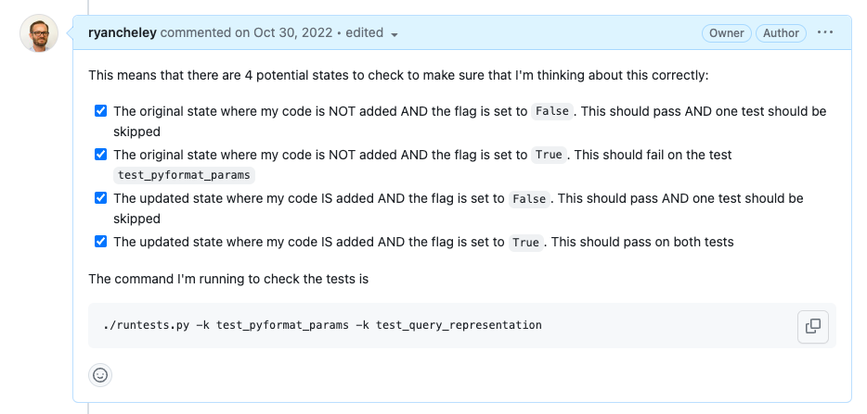
Notes:
Four States to check
The original state where my code is NOT added AND the flag is set to False. This should pass AND one test should be skipped
The original state where my code is NOT added AND the flag is set to True. This should fail on the test test_pyformat_params
The updated state where my code IS added AND the flag is set to False. This should pass AND one test should be skipped
The updated state where my code IS added AND the flag is set to True. This should pass on both tests

Slide 57
Testing
Run the tests to check new behavior
Run entire test suite

Slide 58
✅ Replicate the Bug 🐛
✅ Read some docs 📖
✅ Write some code ✍🏻
✅ Test the Code 🧪
Write down what you learned 📜

Slide 59
📜
Notes:
Write down what you’re learning as you’re learning … because we all do this, right?
I didn’t, until I saw Simon Willison talk at DjangoCon US 2022 titled, “Massively increase your productivity on personal projects with comprehensive documentation and automated tests”

Slide 60
Public Notes
Notes:
This talk included an idea called ‘public notes’.
I highly recommend watching that talk and implementing the public notes idea
This was the first time I used the idea,
but I've used it a few more times since then
as I try to learn about a thing.
I’ve even started doing it at my joby-job
Essentially you use an issue
(in this case a GitHub issue)
as a spot to work through a problem
and leave yourself breadcrumbs
for what you’ve tried and learned,
basically doing what you would do
in the ‘scientific method’

Slide 61
My Public Notes
Notes:
In my notes there’s a lot of back and forth, two steps backward, 1 step forward kind of things, but even looking at it now, I can see my thought process for how the bug ended up getting fixed

Slide 62
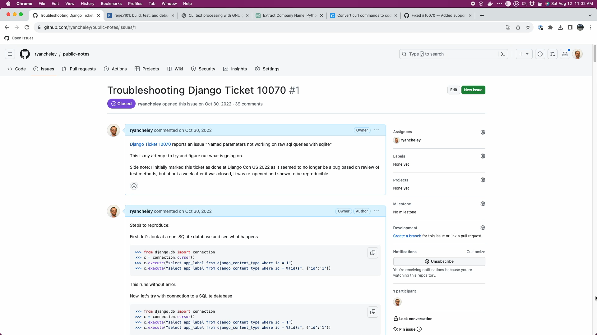
Notes:
40 comments as a conversation to myself, back and forth from Oct 30, 2022 to Nov 8, 2022 (10 days!)

Slide 63
Feedback from Shia Berger
This looks quite fragile
consider, e.g. a query which, for whatever reason, includes `)s` in a string constant
A more robust approach is to create a naming-dict from all the param-names, and use that to format the original text:
naming_dict = { param: f":{param}" for param in param_names} query = query % naming_dict
Where param_names can be collected either by parsing the query, or from the parameters given.
Notes:
ACTION: Take a sip of water
Read each element
If this would have been all that was supplied I might have been a bit discouraged because honestly, I was a bit confused, but …

Slide 64
Feedback from Shia Berger
take a look at the Oracle backend -- I wrote that piece too long ago to remember which it takes, but at the time I knew what I was doing there
Notes:
Shia also left this in the comment

Slide 65
Feedback from Simon Charette
I agree with Shai that we should avoid using regex here.
The most straightforward solution I can think of, I haven't looked at the Oracle implementation in details, would be to simply implement __getitem__
This will ensure the backend reports the low level _missing param_ message in cases a parameter is missing instead of a KeyError during the Django _translation_ phase

Slide 66
The fix
Notes:
Ultimately the fix was made, but it wasn’t just *me*. I had a lot of help in getting the code to the right spot.
Nick Pope
Shia Berger
Simon Charette
Mariusz Felisiak

Slide 67
Incorporating Feedback
General Idea
args = {k: ":%s" % k for k in params}
query %= args
Notes:
My general idea (after a couple of hours of banging my head against the wall) is that the param_list is a generator. I essentially need to take the data from that generator (which yields a dictionary) and do what was done with the execute method which looks like this:
The problem is that when I take the param_list generator to do something with it I USE UP the generator. So my understanding of how to work with generators is kind of broken maybe

Slide 68
Incorporating Feedback
Updated General Idea
param_list = [p for p in param_list]
Notes:
turns out my idea for generators is correct, it was my implementation that was ‘missing something’.
The executemany method doesn’t CARE what kind of iterable is in the param_list if just wants ANY kind of iterable. Once that clicked I realized I could just set the param_list to a list comprehension of itself, i.e.
this means that my generator doesn’t get used up when I pass it to the return at the end of the method.
It’s small things like this that can be super hard to know, even harder to learn, but are worth the struggle of working through.

Slide 69
My initial Code
def execute(self, query, params=None):
if params is None:
return Database.Cursor.execute(self, query)
if hasattr(params, "keys"):
args = {k: ":%s" % k for k in params}
query = query % args
query = self.convert_query(query)
return Database.Cursor.execute(self, query, params)

Slide 70
My initial Code
def executemany(self, query, param_list):
param_list = [p for p in param_list]
try:
if hasattr(param_list[0], "keys"):
args = {k: ":%s" % k for k in param_list[0]}
query = query % args
except IndexError:
pass
query = self.convert_query(query)
return Database.Cursor.executemany(self, query, param_list)

Slide 71
My initial Code
def convert_query(self, query):
return FORMAT_QMARK_REGEX.sub("?", query).replace("%%", "%")

Slide 72
PR from Nick Pope
def execute(self, query, params=None):
if params is None:
return Database.Cursor.execute(self, query)
names = list(params) if isinstance(params, Mapping) else None
query = self.convert_query(query, names=names)
return Database.Cursor.execute(self, query, params)

Slide 73
PR from Nick Pope
def executemany(self, query, param_list):
# Extract names if params is a mapping, i.e. we're using `pyformat` paramstyle.
# We need to peek carefully as we could be passed a generator instead of a list. peekable, param_list = tee(iter(param_list))
if (params := next(peekable, None)) and isinstance(params, Mapping):
names = list(params)
else:
names = None
query = self.convert_query(query, names=names)
return Database.Cursor.executemany(self, query, param_list)

Slide 74
PR from Nick Pope
def convert_query(self, query, *, names=None):
if names is None:
# Convert from `format` paramstyle to `qmark` paramstyle.
# If a literal `%s` is required it must be escaped as `%%s`.
return FORMAT_QMARK_REGEX.sub("?", query).replace("%%", "%")
else:
# Convert from `pyformat` paramstyle to `named` paramstyle.
# This is conveniently consistent - it also converts `%%s` to `%s`.
return query % {name: f":{name}" for name in names}

Slide 75
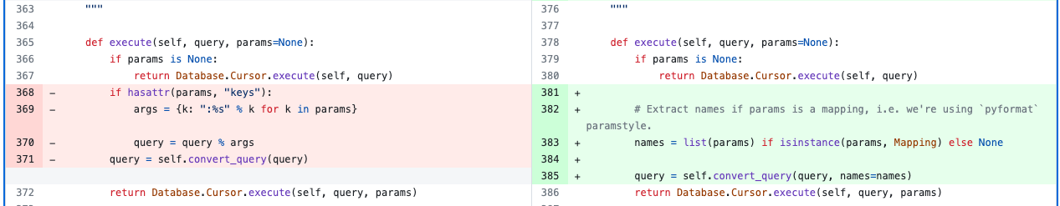
Unified Diff of Code Here

Slide 76
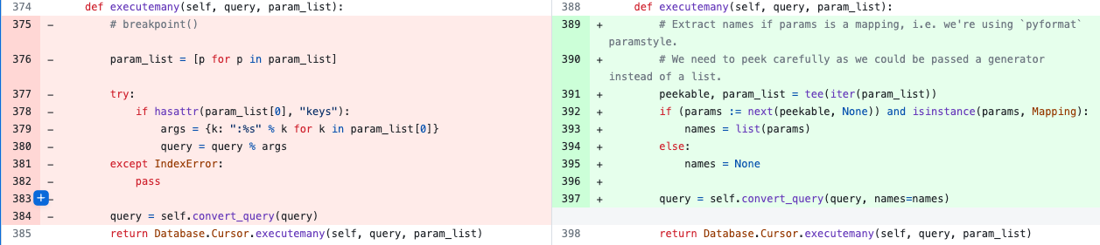
Unified Diff of Code Here

Slide 77
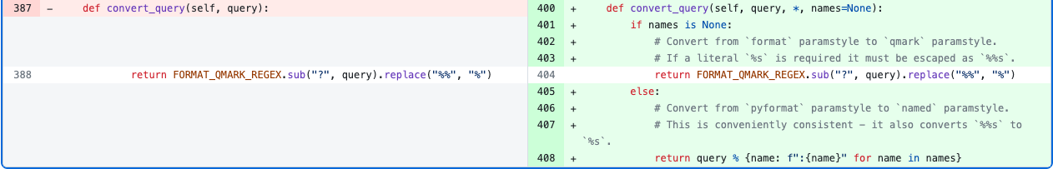
Unified Diff of Code Here

Slide 78
BONUS!

Slide 79
Update to SQLite Docs based on this work!
The documentation for sqlite3.paramstyle states that only qmark and numeric styles are supported for parameter placeholders but, according to the SQLite documentation, the named style is also supported.

Slide 80
The community
Notes:
Ultimately the fix was made, but it wasn’t just *me*. I had a lot of help in getting the code to the right spot.
Shia Berger
Simon Charette
Nick Pope
Mariusz Felisiak

Slide 81

Shia Berger

Slide 82
Identified fragility
Notes:
Feedback that the approach had some fragility https://code.djangoproject.com/ticket/10070#comment:28
with Simon Charette agreeing https://code.djangoproject.com/ticket/10070#comment:29
And that regex should be avoided

Slide 83

Simon Charette

Slide 84
Gave great Keynote at DjangoCon US 2022 on the State of the ORM
Awesome primer on ORM at Sprints
Update to the docs!
Notes:
He gave a great keynote at DjangoCon US 2022
And an awesome primer on the ORM in general at the sprints
Remember to update the docs!

Slide 85
Nick Pope

Slide 86
PR on my PR to help improve the code
Remove Code Duplication
generators
Notes:
There is duplication which should be pushed down into .convert_query().
Converting param_list to a list in .executemany() will saddle us with poor performance. We many have been passed a generator and the current approach will force all of the parameters to be materialized. The approach needed requires that we can peek at the first item in the generator without consuming the lot.

Slide 87

Mariusz Felisiak

Slide 88
Simplified comments
Merged the PR

Slide 89
Contributions Since
Django Packages
Documentation improvements
Code Reviews
Pelican-Plugins
New Plugin PR opened
Implemented Django at my employer

Slide 90
Lessons

Slide 91
The ORM can seem BIG and Scary
Notes:
The ORM can seem big and scary
The code for Django can seem big and scary

Slide 92
The Code for Django can seem BIG and Scary
Notes:
The ORM can seem big and scary
The code for Django can seem big and scary

Slide 93
But remember
Notes:
The ORM can seem big and scary
The code for Django can seem big and scary

Slide 94
The Django ORM …

Slide 95
Is Python

Slide 96
In fact, all of Django …

Slide 97
Is Python

Slide 98
Looking at Tickets
Notes:
So when you go to look for a ticket to take, remember that there is an amazing community here that wants to see you succeed …

Slide 99
Look At 👀
Read 📖
Write ✍🏻
Notes:
and at the end of the day
the code you’re going to
look at,
read,
and write

Slide 100
Is Python

Slide 101
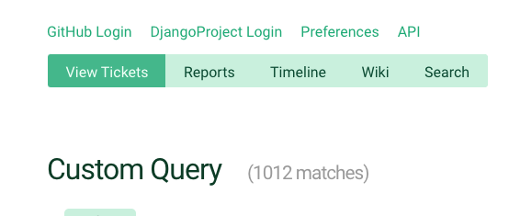
Notes:
When you’re ready to dive in to one of the currently <> open tickets, just keep that in mind

Slide 102

Trac
Notes:
And because this is Django, there is great documentation on how to triage tickets and work through them

Slide 103
Notes:
Back to Mt Whitney
I was **only** three miles from the summit, but I just wasn’t feeling **it**.
My fellow hikers didn’t discourage me from continuing, but they didn’t really encourage me either.
I didn’t make it to the summit that day and it’s been a regret ever since. I’ve not attempted another big hike
But why am I telling this story? What does this have to do with fixing a bug in the Django ORM.
When the bug wasn’t resolved I had an option to ignore it / give up. I could have NOT gone to the summit of the BUG
But the community helped me to work through it. The solution that was ultimately submitted and merged wasn’t just mine, it was through the hard work of a couple of different people.
This community wants you to succeed. They want you to learn.
If this community had been up there with me that day,
I’m 100% sure
that I would have made it to the summit
because of the encouragement that is provided
and the determination to want **you** to succeed

Slide 104
So remember …

Slide 105
Your Framework needs YOU

Slide 106
Community
Notes:
And there’s a great community to support you and wants to see you succeed and learn

Slide 107
Thank you

Slide 108
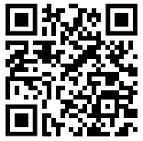
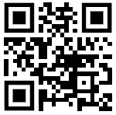
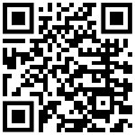
Find me on …
Platform | QR Code
Mastodon https://mastodon.social/@ryancheley
GitHub https://github.com/ryancheley/
LinkedIn https://www.linkedin.com/in/ryan-cheley/

Slide 109
Reference Links
Item
Your Web Framework Needs You! (Slide XX/27) https://www.youtube.com/watch?v=8eYM1uPKg7c
Increase your productivity on personal projects with comprehensive docs and automated tests – DCUS (Slide XX/47) https://www.youtube.com/watch?v=GLkRK2rJGB0
My Public Notes (Slide XX/49) https://github.com/ryancheley/public-notes/issues/1
Keynote: State of the Object-Relational Mapping (ORM) with Simon Charette (Slide XX/56) https://www.youtube.com/watch?v=HNlGFrIBl8o
Django Triaging Tickets (Slide XX/100) https://docs.djangoproject.com/en/dev/internals/contributing/triaging-tickets/

